Slide 1
Data Insights and Presentation
Visualization by using Tableau

Slide 2
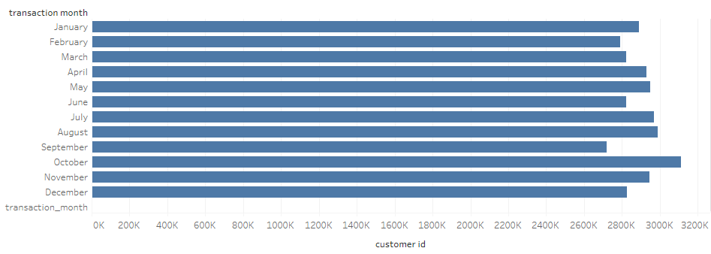
Transaction vs Customer_id

Slide 3
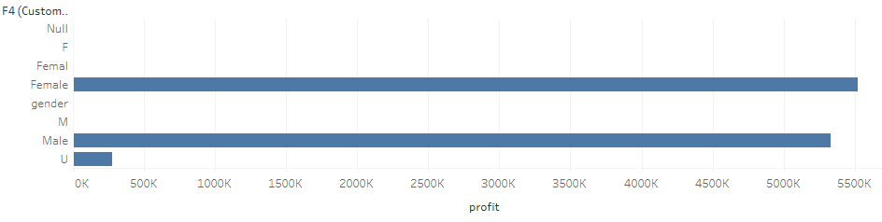
Gender vs Profit

Slide 4
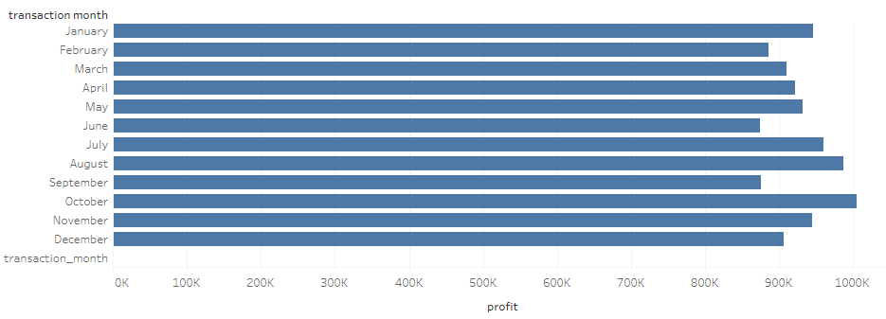
Transaction_month vs Profit

